Slide 1
lareat
Cost/Revenue Recommendations
Anna Razdolskiy

Slide 2
Performance Summary
Branch Strategy
Fleet Renewal
Transaction Revenue Considerations

Slide 3
2018 Baseline Metrics It’s Not a Picture; It’s a Movie
Number of cars | 4,000
Number of branches | 50
Gross Revenue | $ 64,866,040.00
Total Cost | $ 31,789,351.36
Profitability | $ 33,076,688.64
Revenue per car | $ 16,216.51
Total Cost per car | $ 7,947.34
Profitability per car | $ 8,269.17
Gross Revenue per branch | $ 1,297,320.80
Cost per branch | $ 635,787.03
Profitability per branch | $ 661,533.77
Total days rented | 399,947
Days rented per car | 100

Slide 4
Homogeneous Performance Across Branches

Slide 5
Strategy 1: Charge More at Airports
22 branches are at airports. Raising prices by 10% generates $2.9M in gross revenue.

Slide 6
Strategy 2: Fleet Renewal
55 Non-profitable vehicles lost -$58K. 100 Most profitable models totaled $1.9M in net revenue.

Slide 7
Large Number of Short Term Transactions

Slide 8
Strategy 3: Require Minimum Rental Period

Slide 9
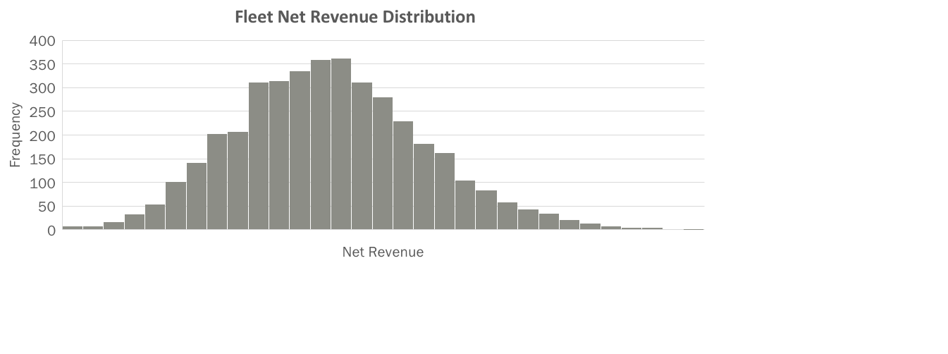
Why Charge Min Price for Short-Term Rentals?

Slide 10
Strategy 4: Set Short Term Minimum Price at $160

Slide 11
Revenue Comparison

Slide 12
Summary
 | Baseline | Charge 10% More at Airports | Fleet Renewal | Reqiure Min Rental Days (4) | Raise Min Price For Short Term Rentals
Number of cars | 4,000 | 4,000 | 4,073 | 4,000 | 4,000
Number of branches | 50 | 50 | 50 | 50 | 50
Gross Revenue | $ 64,866,040.00 | $ 67,723,992.00 | $ 67,769,711.00 | $ 78,732,600.00 | $ 66,657,076.00
Total Cost | $ 31,789,351.36 | $ 31,789,351.36 | $ 34,077,787.80 | $ 31,789,351.36 | $ 31,789,351.36
Profitability | $ 33,076,688.64 | $ 35,934,640.64 | $ 33,691,923.20 | $ 46,943,248.64 | $ 34,867,724.64
Revenue per car | $ 16,216.51 | $ 16,931.00 | $ 16,638.77 | $ 19,683.15 | $ 16,664.27
Total Cost per car | $ 7,947.34 | $ 7,947.34 | $ 8,366.75 | $ 7,947.34 | $ 7,947.34
Profitability per car | $ 8,269.17 | $ 8,983.66 | $ 8,272.02 | $ 11,735.81 | $ 8,716.93
Gross Revenue per branch | $ 1,297,320.80 | $ 1,354,479.84 | $ 1,355,394.22 | $ 1,574,652.00 | $ 1,333,141.52
Cost per branch | $ 635,787.03 | $ 635,787.03 | $ 681,555.76 | $ 635,787.03 | $ 635,787.03
Profitability per branch | $ 661,533.77 | $ 718,692.81 | $ 673,838.46 | $ 938,864.97 | $ 697,354.49
Total days rented | 399,947 | 399,947 | 417,429 | 485,361 | 399,947
Days rented per car | 100 | 100 | 102 | 121 | 100

